Slide 1
Board Presentation
Andrews 72

Slide 2
Mission Statement
Changing how we process processors by supplying the power to create new creativity.
Notes:
Our goal is to supply processors to companies to create the future.
By focusing on new creative companies to be our buyers, we change the way that we make and design our processors to match their needs.

Slide 3
Decision Making Process
Forecasting
Market Growth
Market Share
Customer Buying Criteria
Research and Development
Optimizing Launch Date
Marketing
Promo & Sales Budget
Production
Maximize Production for Low-Tech
Optimizing Worker Training
Financing
Leveraging Debt
Paying Dividends
Final Adjustments
Final Adjustments to ensure Balance Sheet Scoreboard

Slide 4
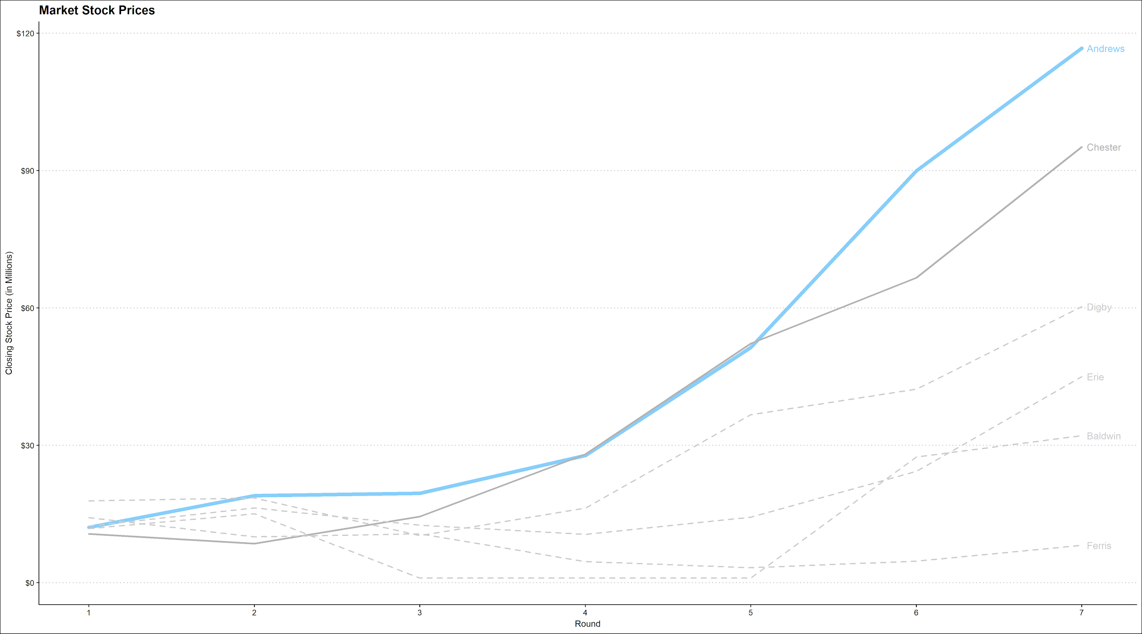

Slide 5
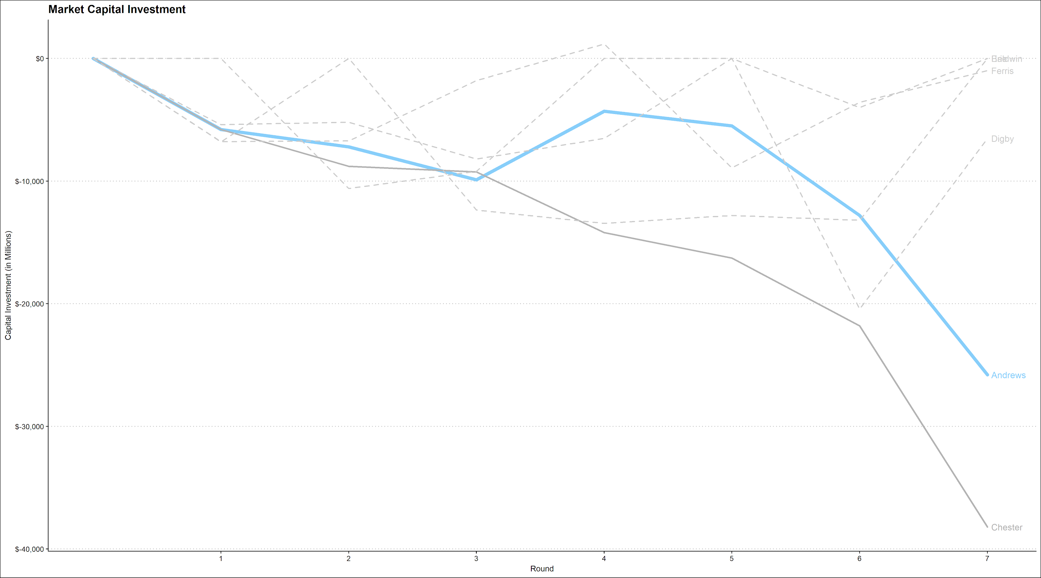

Slide 6
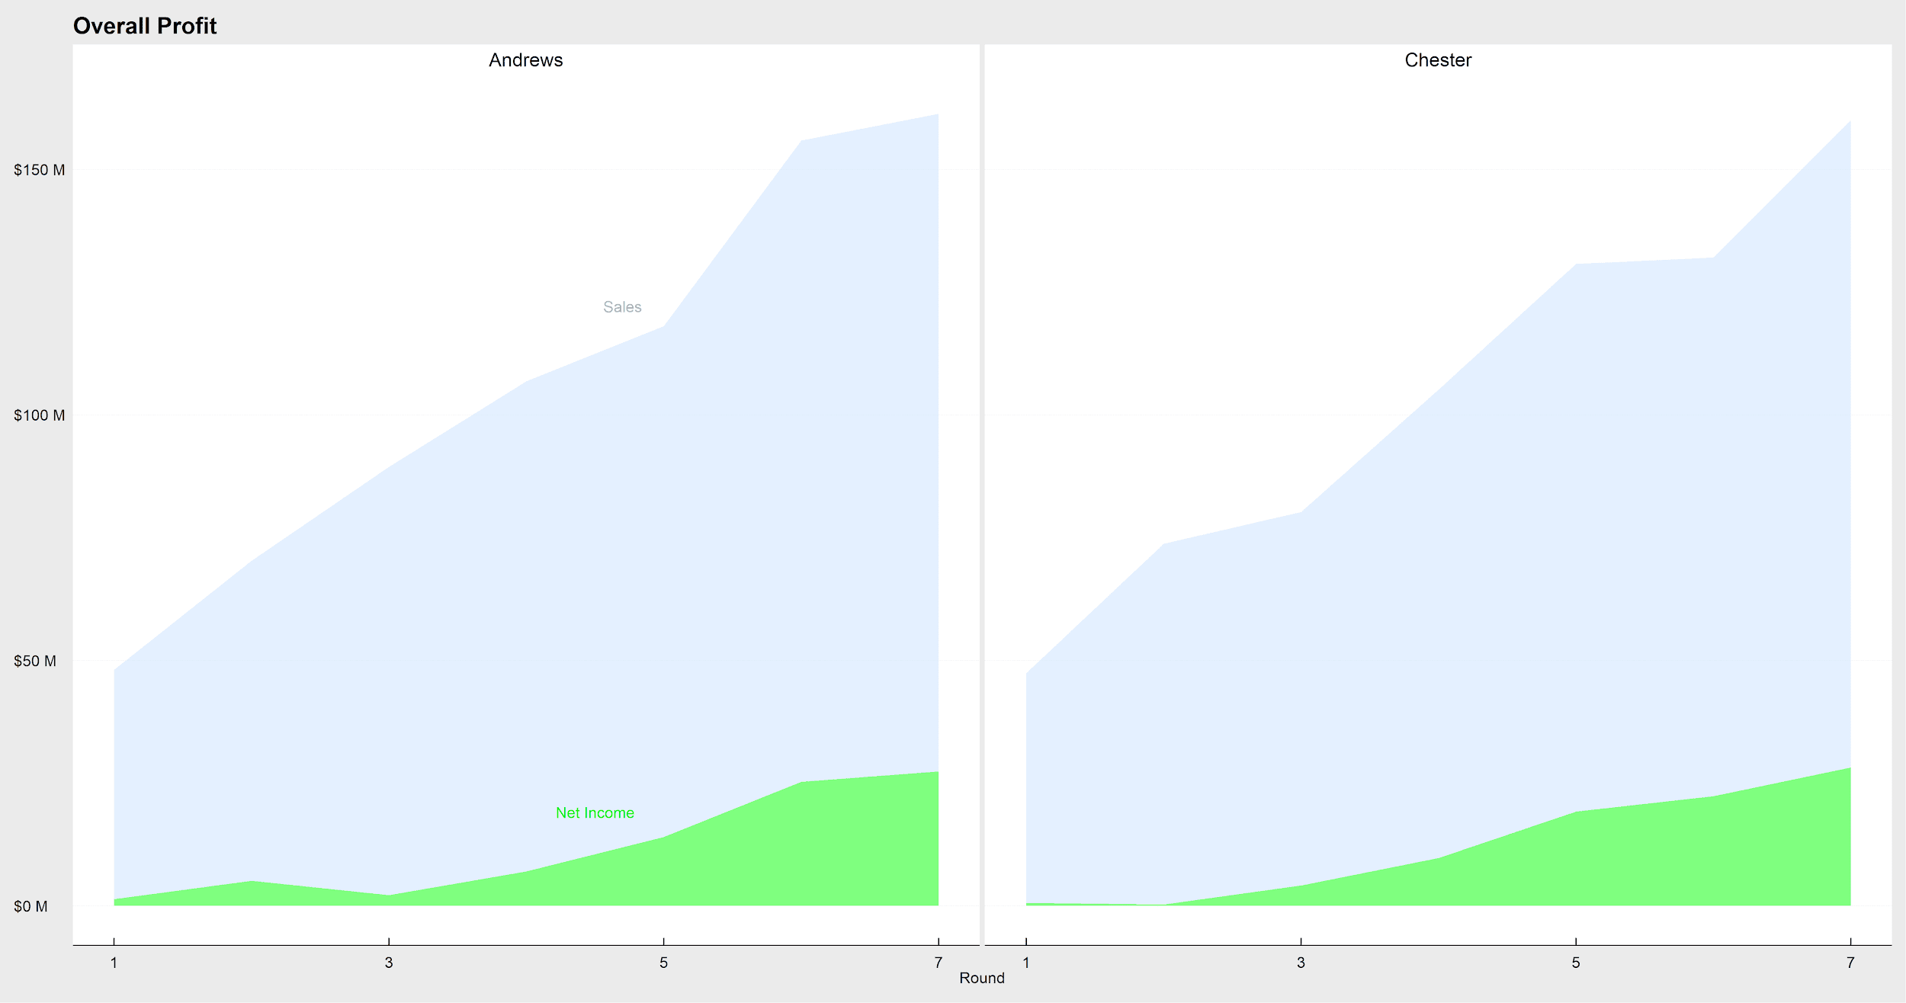

Slide 7
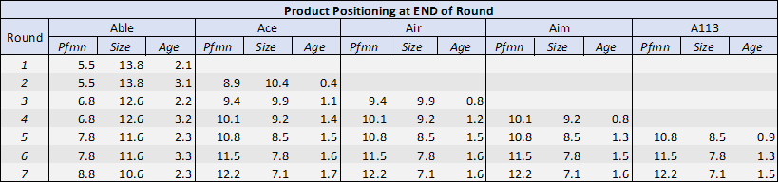
Products & Positioning

Slide 8
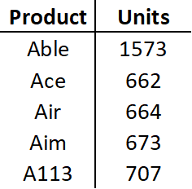
Round 8 Forecast Projections

Slide 9
Total Revenue (in millions)
Low Tech
Able: 1,571($34.50) = $54,200
High Tech
Ace: 662($45.00) = $29,790
Air: 664($45.00) = $29,880
Aim: 678($45.00) = $30,150
A113: 707($45.00) = $31,185
Total Revenue: $175,205

Slide 10
Round 8 Projections
Net Income: $36,238
ROS%: 20.6%
ROA%: 30.2%
ROE%: 55.4%
Net change in cash position: $5,262
Stock Price: $149.75 (+ $33.03)

